Slide 1



META-EVALUATION CHATBOT
Using Large Language Model (LLM)
Team Mavericks:
Arun Totad
Visha Shende
Akshara Reddy
Shivani Rana
Swarna Doppa

Slide 2


Introduction
Create a chatbot that should be able to perform Meta Evaluation (evaluating human evaluations).
Current scope for the project would be to do evaluations based on the set of parameters hardcoded into chatbot, later this can be further extended to cater to variety of industries by optimizing the parameter values.

Slide 3

Minimum Viable Product
Creating a chatbot which can accept a pdf document as input.
Chatbot should be context aware and does Natural Language Processing.
It should be able to understand and summarize the text from the uploaded document and return an output.

Slide 4
Methodology
LangChain
Ollama (Llama2 model)
LangChain is an application development framework for Large Language Models (LLMs). It provides a set of abstractions and tools to build applications with LLMs as a core component.
Ollama is an open-source language model based on the Llama2 architecture. It is a powerful and flexible model that can be used for a variety of natural language processing tasks.
ChainLit
Retrieval Augmented Generation (RAG)
ChainLit is an open-source Python platform for deploying and running LLM-based applications. It provides a set of tools and utilities to simplify the process of building and deploying LLM-powered applications.
Retrieval Augmented Generation (RAG) is an approach used to feed custom data filtering features to a chatbot. It combines the power of large language models with the ability to retrieve and incorporate relevant information from external sources.

Slide 5

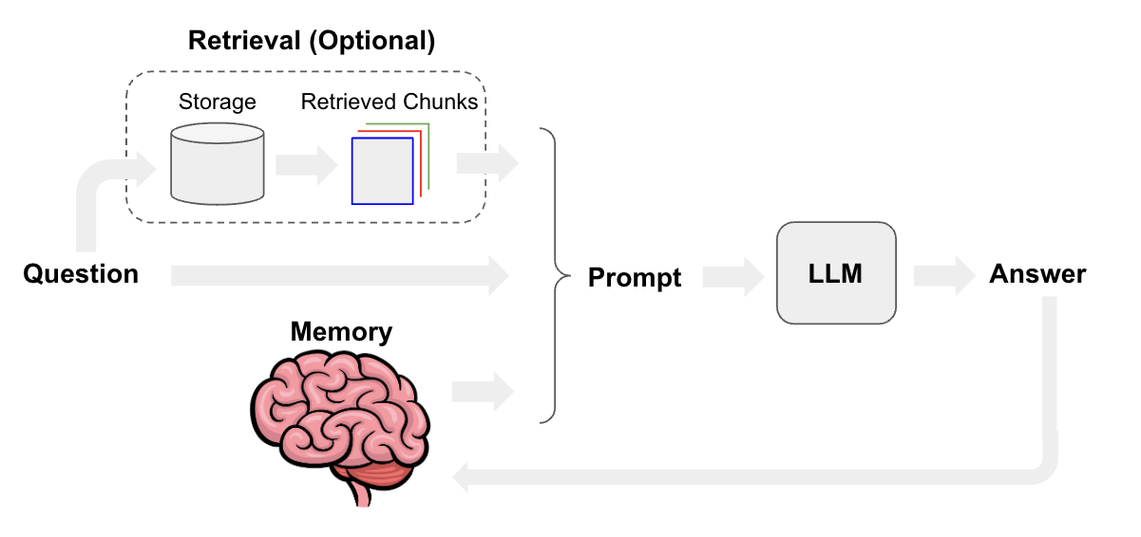
RAG Architecture
Retrieval Augmented Generation (RAG) is an approach used to feed custom data filtering feature to a chatbot. It combines the power of large language models (LLMs) with the ability to retrieve and incorporate relevant information from external sources. This allows the chatbot to provide more accurate and contextual responses by leveraging both the broad knowledge of the LLM and the specific information retrieved from the custom data sources.

Slide 6

Phase I – Criteria
There were a total of 5 criteria and 30 meta evaluation standards in which we had to score any primary evaluation.
Utility Standards
Feasibility Standards
Propriety standards
Accuracy Standards
Evaluation Accountability Criteria

Slide 7
Phase II – Design
We focused mainly on Accuracy. It has around 8 meta-evaluation standards and Each of the standards have around 6 question in it.
Reframing the questions in a way that the response is True and False.
True gets score 1 and false a 0.
Each criteria will be summed up and a mathematical formula determines the final score.

Slide 8

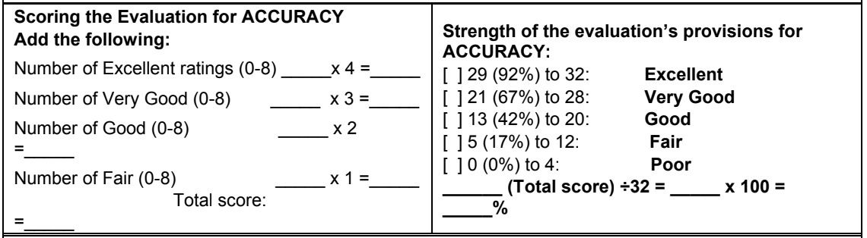
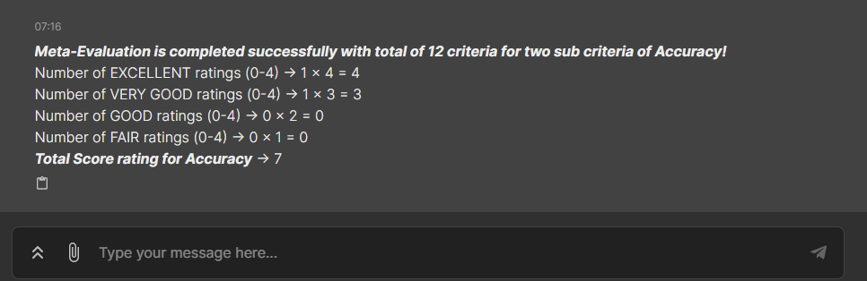
Phase II - Score
Output :

Slide 9
Challenges
Huge size of pdf took a long time to long since we were executing in local.
Some criteria are vague and have answers which can be subjective.
Answers may change when we reframe the questions.
Evaluation standards are very specific – useful for only these documents.

Slide 10

References: https://python.langchain.com/docs/get_started/introduction
https://docs.chainlit.io/integrations/langchain
https://python.langchain.com/docs/use_cases/chatbots/retrieval
https://python.langchain.com/docs/integrations/vectorstores/chroma

